Slide 1
Chapter 3. The Fundamentals: Algorithms, the Integers, and Matrices
Section 2
Growth of Functions

Slide 2
Outline
Introduction
Big-O Notation
Some Important Big-O Results
The Growth of Combinations of Functions
Big-Omega and Big-Theta Notations

Slide 3
Growth of Functions
Remark
  Study number of operations used by algorithm
  For example, given n elements
    Study the number of comparisons used by the linear and binary search
    Estimate the number of comparisons used by the bubble sort and insertion sort
  Use big-O notation to study this irrespective of hardware

Slide 4
Big-O notation
Big-O notation
  Used extensively to estimate the number of operations in algorithm uses as its inputs grows
  Determine that is it practical to use a particular algorithm to solve a problem as the size of the input increases
  Can compare with two algorithms and determine which is more efficient
    For instance, one algorithm uses 100n²+17n+4 operations and the other uses n³ operations
    The first one is more efficient when n is large even though it uses more operations for smaller values of n, e.g., n=10
  Related to big-Omega and big-Theta notations in algorithm design

Slide 5
Big-O notation
Definition
  Let f and g be functions from the set of integers or the set of real numbers to the set of real numbers, we say f(x) is O(g(x)) if there are positive constants C and k such that
  |f(x)| ≤ C⋅|g(x)|, whenever x > k
  Read as “f(x) is big-oh of g(x)”
Remark
  The constants C and k are called witnesses to the relationship “f(x) is O(g(x))”
    Need only one pair of witnesses to this relationship
    To show f(x) is O(g(x)), need only one pair of constants C and k, such that |f(x)| ≤ C⋅|g(x)|

Slide 6
Big-O notation
  When there is one pair of witnesses, there are infinitely many pairs of witness
    Let C < C’ and k < k’, we have |f(x)| ≤ C⋅|g(x)| ≤ C’⋅|g(x)| when x > k’ >k

Slide 7
Big-O notation
Example.
  Show that f(x) = x²+2x+1 is O(x²)
  Solution.
  We observe that we can estimate size of f(x) when x>1 because x < x² and 1 < x² when x > 1, or
  0 ≤ x²+2x+1 ≤ x²+2x²+x² = 4x² when x > 1.
  Thus, we can take c = 4 and k = 1 to show that f(x) is O(x²)
  Alternatively, when x > 2, 2x ≤ x² and 1 ≤ x²,
0 ≤ x²+2x+1 ≤ x²+x²+x²=3x²
  so C = 3, and k = 2 are also witnesses to relation f(x) is O(x²)

Slide 8
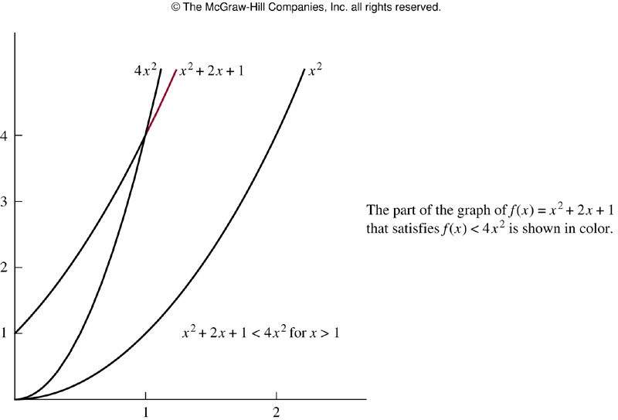
Big-O notation

Slide 9
Big-O notation
Example.
  Observe that in the relation “f(x) is O(x²)”, O(x²) can be replaced by any function with larger values than x²,
    e.g., f(x) is O(x³), f(x) is O(x²+x+7), …
  In this example, f(x) = x²+2x+1, g(x) = x², we say both of these big-O relationships are of the same order
  Sometimes written as f(x) = O(g(x))
  It is acceptable to write f(x)∈O(g(x)) as O(g(x)) represents the set of functions that are O(g(x))

Slide 10
Big-O notation
Remark
  When f(x) is O(g(x)) and h(x) is a function that has larger absolute values than g(x) does for sufficient large value of x, it follows that f(x) is O(h(x))
    Because f(x) is O(g(x)): |f(x)| ≤ c⋅|g(x)| if x > k
    and if |h(x)|>|g(x)| for all x > k, then
    |f(x)| ≤ C⋅|h(x)| if x > k
  When big-O notation is used, Big-O provides an upper bound on a function (to within a constant factor). Let f(x) is O(g(x)), it is a good idea that the g(x) is chosen to be as small as possible.

Slide 11
Big-O notation
Remark
  When O(g(x)) is considered as a set of functions
    Commonly used notation
      f(x) = O(g(x))
    Correct notation
      f(x) ∈ O(g(x))
    Meaningless statement
      O(g(x)) = f(x)

Slide 12
Big-O notation
Properties of Big-O
  If “f(x) is O(g(x))” then g(x) grows at least as fast as f(x)
  “f(x) is O(g(x))” iff O(f(x)) ⊆ O(g(x))
  If “f(x) is O(g(x))” and “g(x) is O(f(x))” then O(f(x)) = O(g(x))
  If “f(x) is O(g(x))” and “h(x) is O(g(x))” then (f+h)(x) is O(g(x))
  If a is a scalar and “f(x) is O(g(x))”, then a*f(x) is O(g(x))
  If “f(x) is O(g(x))” and “g(x) is O(h(x))”, then f(x) is O(h(x))

Slide 13
Big-O notation
Common Complexity Functions
Complexity | Term
O(1) | constant
O(log n) | logarithmic
O(n) | linear
O(nlog n) | n⋅log n
O(n^{b}) | polynomial
O(b^{n}), where b > 1 | exponential
O(n!) | factorial

Slide 14
Big-O notation
Example.
  Show that 7x² is O(x³)
  Solution.
  When x >7, 7x² < x³, So let c = 1 and k = 7, we see 7x² is O(x³)
  Alternatively, when x > 1, 7x² < 7x³ and so that C = 7 and k = 1, we have the relationship 7x² is O(x³)

Slide 15
Big-O notation
Example.
  Show that n² is not O(n)
  Solution.
  To show that n² is not O(n), we must show that no pair of constants C and k exist such that n² ≤ C⋅n when n > k
  That is, when n > 0, we have to show that n ≤ C
  No matter what C and k are, the inequality n ≤ C cannot hold for all n with n > k when n > k and n > C.

Slide 16
Big-O notation
Example.
  Previous example shows that 7x² is O(x³). Is it also true that x³ is O(7x²)
  To show that, x³ ≤ C⋅7x² is equivalent to x ≤ 7c whenever x>k and x≠0
  No c exists for which x ≤ 7C for all x > k
  Thus x³ is not O(7x²)

Slide 17
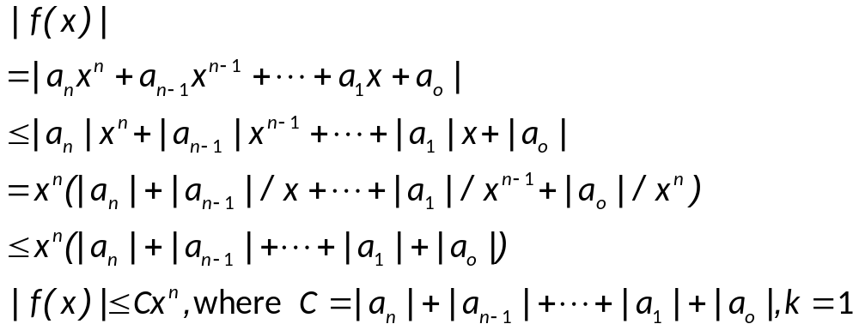
Some Important Big-O Results
Theorem 1
  Let f(x)=a_{n}x^{n}+a_{n-1}x^{n-1}+…+a₁x+a₀, where a₀, a₁, …, a_{n-1}, a_{n} are all real numbers, then f(x) is O(x^{n})
  Proof.
  Using the triangle inequality, if x>1

Slide 18
Some Important Big-O Results
Example.
  Big-O notation of the sum of first n positive integers
    1+2+…+n ≤ n+n+…+n = n², O(n²) with C=1, k=1
    Alternatively, O(n(n+1)/2) = O(n²)
Example.
  Big_O notation of n!
    n!=1∙2∙3∙ … ∙n ≤ n ∙ n ∙ n … n = n^{n}, O(n^{n}) with C=1, k=1
  Big_O notation of log(n!)
    Log(n!) ≤ log(n^{n}) = n⋅logn, log(n!) is O(nlogn) with C=1, k=1

Slide 19
Some Important Big-O Results
Example.
  We know that n<2^{n} when n is a positive integer. Show that this implies n is O(2^{n}) and use this to show that logn is O(n)
  Solution.
  n is O(2^{n}) by taking C=1 and k=1: n<2^{n}
  Thus, log₂n < n, so log₂n is O(n)
  If we have logarithms to a different base b than 2, we still have log_{b}n is O(n) as
  log_{b}n = log₂n/log₂b < (1/log₂b)⋅n
  when n is a positive integer, taking C=1/log₂b and k=1.

Slide 20
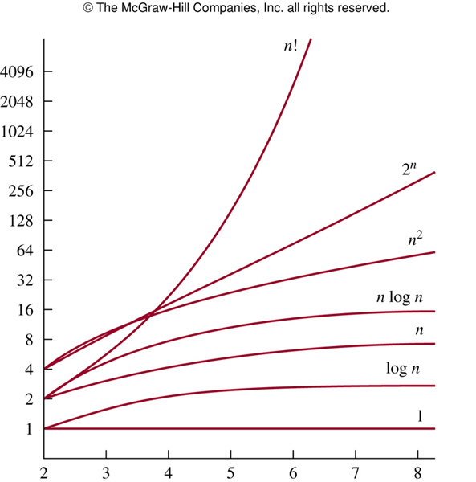
Growth of combinations of functions

Slide 21
Growth of combinations of functions
Remark.
  Many algorithms are made up of two or more separate subprocedures
Theorem 2
  Suppose f₁(x) is O(g₁(x)) and f₂(x) is O(g₂(x)), then
    (1) (f₁+f₂)(x) is O(max(|g₁(x)|, |g₂(x)|)
    (2) (f₁f₂)(x) is O(g₁(x)g₂(x))
  Proof.(1)
  |f₁(x)|≤ C₁|g₁(x)| with x>k₁, |f₂(x)|≤ C₂|g₂(x)| with x>k₂
  |(f₁+f₂)(x)|=|f₁(x)+f₂(x)| ≤ |f₁(x)|+|f₂(x)|
  |f₁(x)|+|f₂(x)| ≤ C₁|g₁(x)|+ C₂|g₂(x)|
  = (C₁+ C₂)|g(x)|
  = C|g(x)|
  here C = C₁+ C₂, |g(x)|= max{|g₁(x)|,|g₂(x)|}

Slide 22
Growth of combinations of functions
Theorem 2
  Suppose f₁(x) is O(g₁(x)) and f₂(x) is O(g₂(x)), then
    (1) (f₁+f₂)(x) is O(max(|g₁(x)|, |g₂(x)|)
    (2) (f₁f₂)(x) is O(g₁(x)g₂(x))
  Proof.(2)
  |(f₁f₂)(x)|=|f₁(x)|⋅|f₂(x)|
  ≤ C₁|g₁(x)|⋅ C₂|g₂(x)|
    ≤ C₁C₂|(g₁g₂)(x)|
    ≤ C|(g₁g₂)(x)|
    here c = c₁c₂, k = max(k₁, k₂)
Corollary
  If f₁(x) and f₂(x) are both O(g(x)), then (f₁+f₂)(x) is O(g(x))

Slide 23
Growth of combinations of functions
Example.
  Big-O notation of f(n) = 3nlog(n!)+(n²+3)logn where n is a positive integer
  Solution.
  We know log(n!) is O(nlogn), so the first part is O(n²logn)
  As n²+3 < 2n² when n>2, it follows that n²+3 is O(n²), and the second part is O(n²logn)
  So f(n) is O(n²logn)

Slide 24
Growth of combinations of functions
Example.
  Big-O notation of f(x) = (x+1)log(x²+1) + 3 x²
  Solution.
  Note x+1 is O(x) and x²+1 ≤ 2x² when x>1
  So, log(x²+1) ≤ log(2x²) = log 2+ log x²
  = log 2+ 2 log x ≤ 3 log x , if x >2
  Thus, log(x²+1) is O(log x)
  The first part of f(x) is O(xlogx)
  Also, 3x² is O(x²)
  So, f(x) is O(max(xlogx, x²)) = O(x²) as xlogx ≤ x² for x >1

Slide 25
Big-Omega
Remark
  Big-O notation only provides an upper bound in terms of g(x) for f(x)
Definition
  Let f and g be functions from the set of integers or the set of real numbers to the set of real numbers. We say f(x) is ?Ω (g(x)) if there are positive constants c and k such that |f(x)|≥ C|g(x)| when x>k
  Read as “f(x) is big-Omega of g(x)”

Slide 26
Big-Omega
Example.
  f(x) = 8x³+5x²+7 is Ω (g(x)) where g(x) = x³
  It is easy to see as f(x) = 8x³+5x²+7 ≥ 8x³ for all positive numbers x
  This is equivalent to say g(x) = x³ is O(8x³+5x²+7)

Slide 27
Big-Theta notation
Definition
  Let f and g be functions from the set of integers or the set of real numbers to the set of real numbers. We say that f(x) is Θ(g(x)) if f(x) is O(g(x)) and f(x) is Ω (g(x))
  When f(x) is Θ(g(x)) , we say f is big-Theta of g(x), and we also say f(x) is of order g(x)
  When f(x) is Θ(g(x)) , there are positive constants c₁, c₂, and k such that
  C₁|g(x)| ≤ |f(x)| ≤ C₂|g(x)| whenever x > k.
  When f(x) is Θ(g(x)), g(x) is Θ(f(x))
  f(x) is Θ(g(x)) if and only if f(x) is O(g(x)) and g(x) is O(f(x))

Slide 28
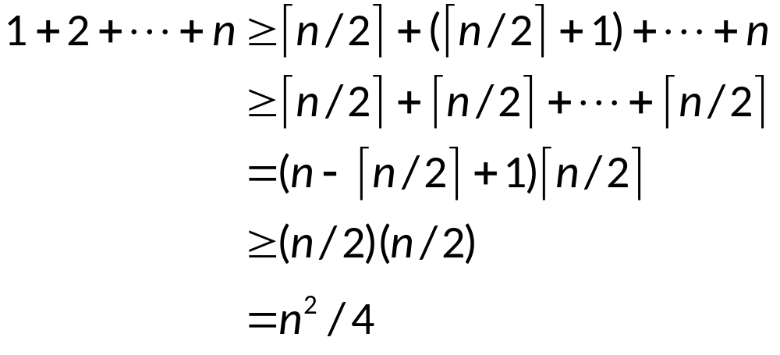
Big-Theta notation
Example.
  Let f(n) = 1+2+…+n. We know that f(n) is O(n²), to show that f(x) is of order n², we need to find C and k such that f(n) > Cn² for large n>k
  f(n) is O(n²) and Ω (n²), thus f(n) is Θ(n²)

Slide 29
Big-Theta notation
Remark.
  We can show that f(x) is Θ(g(x)) if we can find positive real numbers C₁ and C₂ and a positive number k, such that
  C₁|g(x)| ≤ |f(x)| ≤ C₂|g(x)| when x>k
  This shows f(x) is O(g(x)) and f(x) is Ω (g(x))

Slide 30
Big-Theta notation
Example.
  Show that 3x²+8xlogx is Θ(x²)
  Solution.
  As 0 ≤ 8xlogx ≤ 8x², it follows that
  3x²+8xlogx ≤ 11x² for x>1
  Consequently
  3x²+8xlogx is O(x²)
  Clearly 3x²+8xlogx is Ω (x²)
  Consequently
  3x²+8xlogx is Θ(x²)

Slide 31
Polynomial
Remark.
  One useful fact is that the leading term of a polynomial determines its order
  E.g., f(x) = 3x⁵+x⁴+17x³+2 is of order x⁵
Theorem 4
  Let f(x) = a_{n}x^{n}+a_{n-1}x^{n-1}+…+a₁x+a₀, where a₀, a₁, …, a_{n-1}, a_{n} are all real numbers, then f(x) is of order x^{n}

Slide 32
Assignment
Exercises after 3.2: No.20, 24(b)(d), 38 (ver.6)
Exercises after 3.2: No.26, 30(b)(d), 44 (ver.7)

